Slide 1
Analyzing Recipes to Predict Healthy Recipes
Brandon Lam
GA – Data Science
Class 30

Slide 2
Problem Statement
Eating healthy is a challenge. Armed with nutritional content information, I would like use those features to determine healthy recipes.
Healthy recipes are defined as recipes that are lower than 500 calories

Slide 3
Hypothesis
Fat and sodium content will directly correlate with calorie count.
Certain ingredients will correlate with lower Calorie count

Slide 4
Dataset
Epicurious’s "Recipes by Nutrition and Ratings“ found on Kaggle
Contained over 600 columns with extensive classification information about each recipe, such as ingredients, recipe occasion, nutritional content. Etc .

Slide 5
Goal
Predict healthy recipes based on protein, sodium and fat.

Slide 6
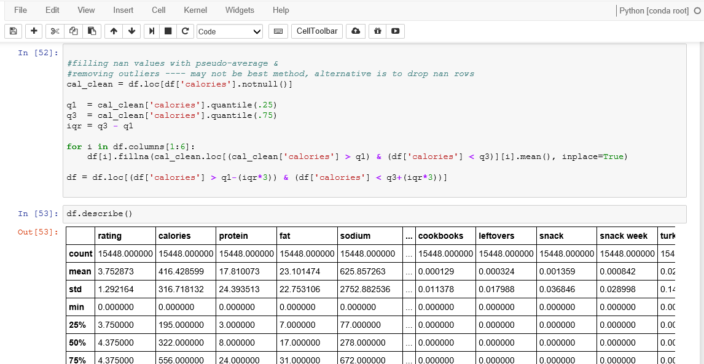
Removing Outliers and Filling NaN Values
Notes:
Important to set up the foundations to create a linear regression

Slide 7
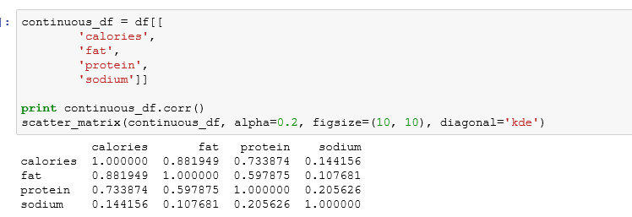
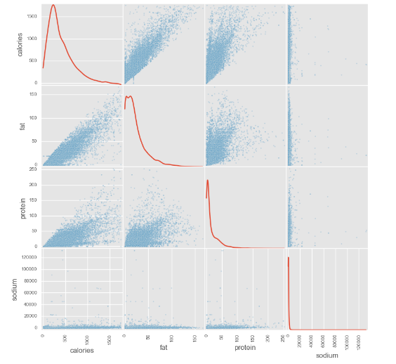
Correlation

Slide 8
Linear Regression

Slide 9
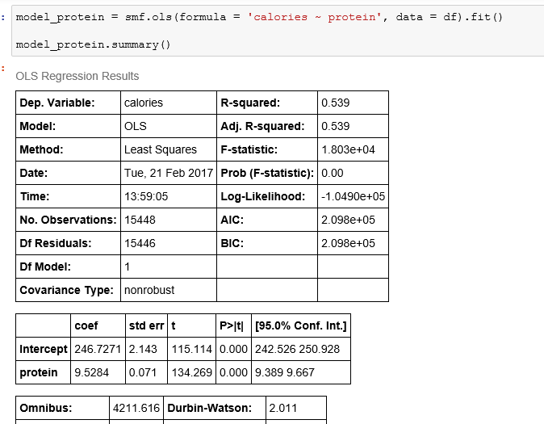
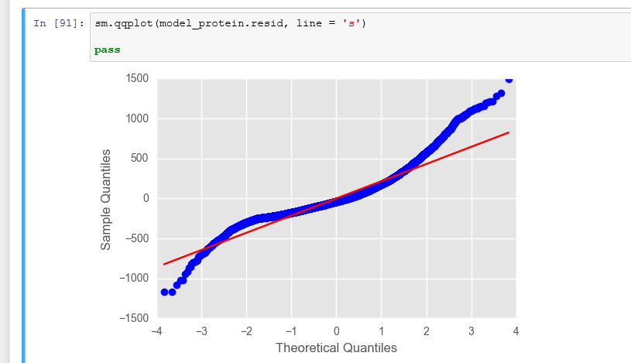
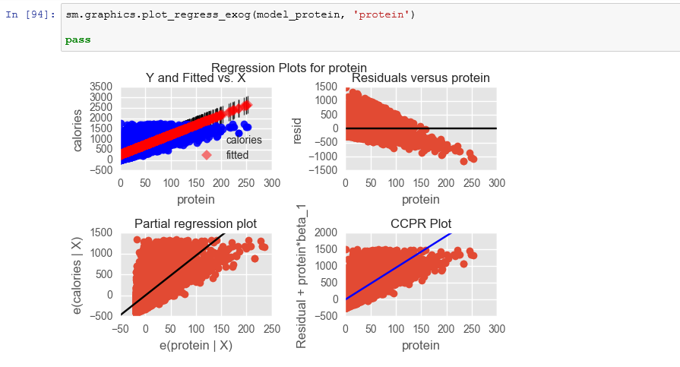
Simple Linear Regression for Protein and Calories

Slide 10
Next Steps
Further data cleaning to separate the ingredients from other recipe descriptors
Classify ingredients to further reduce the number of features
Analyze ingredients via regularization (lasso) and/or PCA
Build a random forest model applying categories of ingredients

